Slide 1
Is Stage at Diagnosis a Predictor of Breast Cancer Survival?
Jolene Branch
Bellevue University
DSC550 Data Mining
August 2, 2020

Slide 2
Questions arose from personal interest
Mother-in law had breast cancer
Personal risk factors
More women Veterans using VA healthcare
“Did my mother-in-law have characteristics that made her less likely to survive?” and if so, “What were they?”
Notes:
Mother-in-law survived five years after diagnosis the first time, then was diagnosed later in live and died rather quickly.
Being overweight with a sedentary lifestyle are known risk factors for cancer.

Slide 3
Tracking down the most complete data set
Many available (Kaggle, Wisconsin, seaborn, UCI Machine Learning Repository, Haberman’s Survival Data)
If I have the entire population, do I need to do test/train?
Original work
National Cancer Institute Surveillance, Epidemiology, and End Results Program (SEER)
Notes:
I thought I could look for the more highly correlated features, then use those in a classification model and compare against true five-year survival rates.
If I have the entire population, do I need to do test/train?
There are so many breast cancer projects out there that I was worried that no matter what I did, it could be speculated that I had copied someone else’s work. So I decided to start entirely from scratch. I used the National Cancer Institute Surveillance, Epidemiology, and End Results Program (SEER)

Slide 4
Challenges with SEER
Complicated, meant for subject matter expert researchers
Risk of selecting redundant features
Shortened/abbreviated feature names are confusing
Choices required ‘up front’ in order to pull a data set
7 million records!
Notes:
With SEER, you have to make many decisions ‘up front.’ And there is no going back without starting over.
Each seemingly simple variable has numerous selections below it. Risk of selecting redundant features is high.
Exporting the data then importing into Jupyter Notebook was challenging.
Probably should have done some filtering in Excel csv file first, such as removing all males! That would have cut the size in half.

Slide 5
Tools and techniques
Goal is binary classification model
Find features highly correlated with five-year survival, then attempt classification
66 columns, mostly of type ‘object
Data definitions not helpful to non-subject matter expert
CLEAN UP THIS DATASET!
Remove males
Only diagnoses made for breast cancer in 2010
Down to 59,000 rows!

Slide 6
Preliminary data review - surprises
Majority survive >= 5 years and cause of death is NOT breast cancer
Data wrangling to get categorical features into numeric
Pre-binned data (age, income, rurality)
Grade/stage of cancer
Encoding did not work same for features
Very few missing values, but a few duplicate patient IDs
Dropped features with same value for all observations
Notes:
Is there a financial or regulatory disincentive for providers to list a cause of death other than breast cancer? Does this count as a treatment failure for the oncology team?
The data wrangling took me a solid two weeks. No two features worked the same. Some had to be unstacked and then converted to numeric. Bins had to be trimmed to just the starting value.
I used get_dummies() for a couple features.

Slide 7
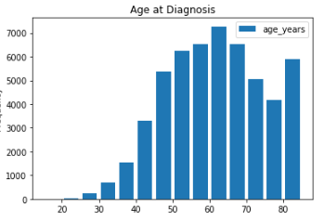

Surprises (continued)
Little correlation between grade/stage at diagnosis and target variable (of 5-year survival)
Age at diagnosis (85+?!)
Notes:
What? Stage/grade of cancer upon diagnosis has very little correlation with five-year survival? How can that be?
Probably no sense in creating a five-year survival classifier based on grade at diagnosis.

Slide 8
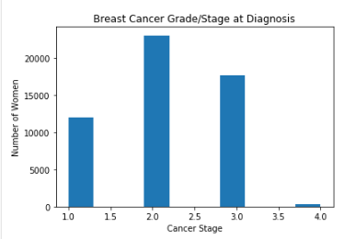
Very few women are diagnosed with the most advanced stage (4)
Notes:
I find this curious. The count of women diagnosed with stage 4 cancer seems like an outlier. This is where domain knowledge is important. I don’t know the diagnostic indicators and differences between stage 3 and 4. The best I can do, without that information, is to speculate that perhaps oncologists do not want to give an initial stage 4 diagnosis for fear that the woman will be so distraught at hearing that news that she might not even attempt treatment.

Slide 9
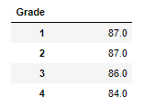
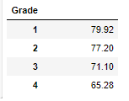
Months survived, median vs. mean, by stage/grade
?
The mean looks more intuitive. The higher the stage/grade of cancer, the less time you would expect to live.
Notes:
I’m sure any serious researcher would have examined this dataset with and without the presence of women who died with cause of death listed as something other than breast cancer. I believe this mean is essentially meaningless for two reasons; 1. It does not distinguish between women who pursued treatment and those who did not (and even which type of treatment, and 2. It does not distinguish between survival time that ended due to breast cancer or due to some other diagnosis.
So at best, the mean life expectancy based on stage/grade of breast cancer from this dataset could be used as a general understanding of what is currently occurring in the field of breast cancer treatment. It cannot be used for prediction or even responsibly used for classification of outcome (in terms of five-year-survival) due to the missing feature of medical interventions (or treatments).

Slide 10
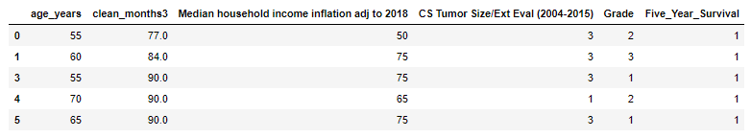
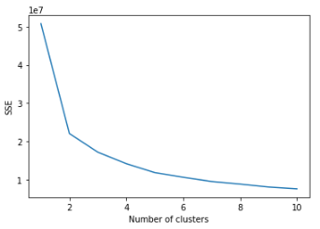
Method and evaluation
K-means classifier identified ‘hinge’ at two clusters
Something doesn’t seem right. Shouldn’t there be at least four clusters, since cancer diagnoses are graded 1-4? There must be enough differentiation among the grades to support more than two clusters!
Notes:
This was a big clue that there is something wrong with my model. I knew going in that there are four ‘stages’ or grades of cancer upon diagnosis. The medical community doesn’t just pick a number. There are standards.

Slide 11
Evaluation using external data source – Codeacademy breast cancer project
Hints to where my model went wrong
1. Overfit
2. Underfit
3. Ideal K Nearest Neighbor
3
1
”You can say a statistical model is said to be overfitted when we train it with a lot of data and when our model gets trained with so much data it starts learning from the noise and inaccurate data entries, so due to this the model is not able to categorize the data correctly because there’s too many details and too much noise… “
2
Notes:
My model or algorithm does not fit the data well enough. “ … can happen when we try to build a linear model with nonlinear data.”

Slide 12
Huge limitation realized
Dataset should have been split by TREATMENT “yes/no” and then type of treatment
The worst type of confounding variable?

Slide 13
Lessons learned
Should have used diagnosis ‘malignant’ or ‘benign’ as the target variable, because then treatment (yes/no/type) would not have time to come into play
Save cohort to a csv file for quicker importing later
Change int64 to int16 for 75% reduction in memory (Tournois, 2018)
Do not use research data set if cleaned up version available
Shorten column names and get rid of spaces

Slide 14
Lessons learned (continued)
Try dimensionality reduction FIRST next time with such a massive data set (Sharma, 2020)
Compress features
Avoid underfitting and noise
Increase efficiency and performance
Maybe 5-year survival isn’t such a good indicator – since nearly everyone makes it 5 years?

Slide 15
Conclusions
No ‘smoking gun’
Initial features of a person probably don’t matter as much as the treatment applied. Even stage of cancer
No way to responsibly classify survivability based on initial presentation; Quality, method, timeliness of treatments need to be included

Slide 16
References
Sharma, P. (2020, May 25). Dimensionality Reduction Techniques: Python. Retrieved from https://www.analyticsvidhya.com/blog/2018/08/dimensionality-reduction-techniques-python/
Surveillance, Epidemiology, and End Results (SEER) Program (www.seer.cancer.gov) SEER*STAT Database: Incidence – SEER Research Data, 9 Registries, Nov 2019 Sub (1975-2017) – Linked to County Attributes – Time Dependent (1990-2017) Income/Rurality, 1969-2018 Counties, National Cancer Institute, DCCPS, Surveillance Research Program, released April 2020, based on the November 2019 submission.
Tournois, G. (2018, December 19). 4 Strategies to Deal With Large Datasets Using Pandas. Retrieved from https://www.codementor.io/@guidotournois/4-strategies-to-deal-with-large-datasets-using-pandas-qdw3an95k
Notes:
Yes, that is the recommended citation that the SEER*STAT site gave me after I selected the database that I wanted to use. Otherwise I would have used:
Cancer of the Breast (Female) - Cancer Stat Facts. (n.d.). Retrieved June 21, 2020, from https://seer.cancer.gov/statfacts/html/breast.html

